Slide 1
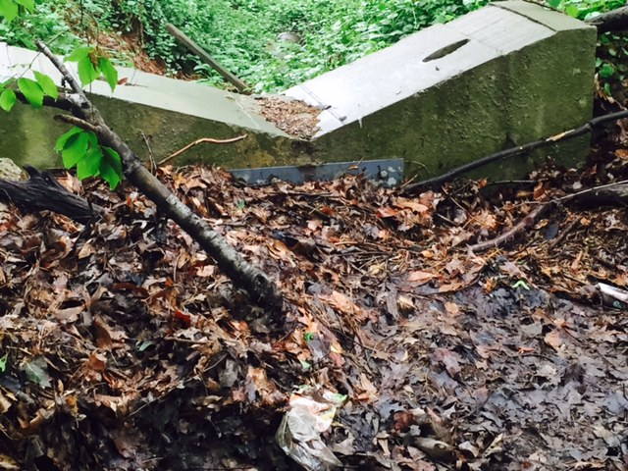
Recently installed spill way to restrict water flow to the lower level of Lake Terrace drive. The grate is completely covered with debris. This appears to be part of the easement. Should be cleaned periodically thought-out the year

Slide 2
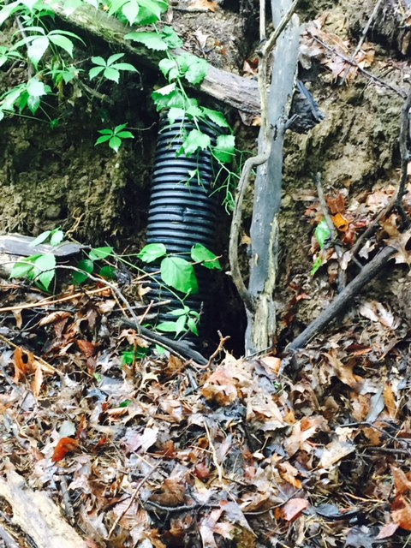
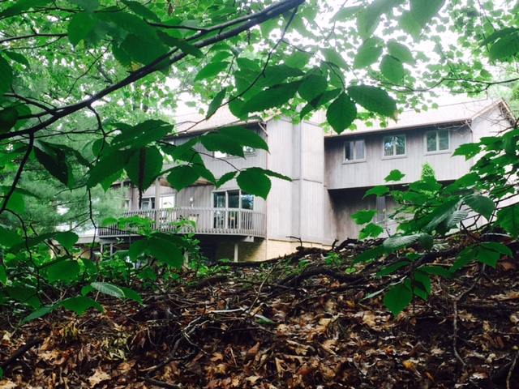
This shows a rain leader from the house(on Silver Valley Blvd) the run-off water is flowing to the lower level of Lake Terrace Drive. Was this approved for the home owner to dump this water in the easement area?

Slide 3
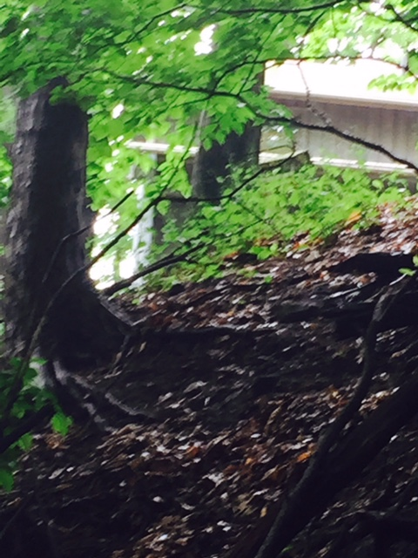
This is a photo of the back of the easement where residents from Silver Valley Blvd are dumping grass clippings , branches and other debris over the gully and into the easement. There is enough natural materials falling in there we don’t need anymore help there.

Slide 4
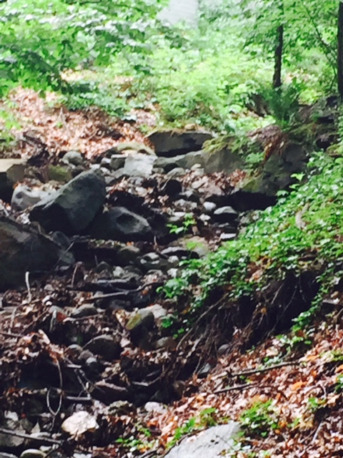
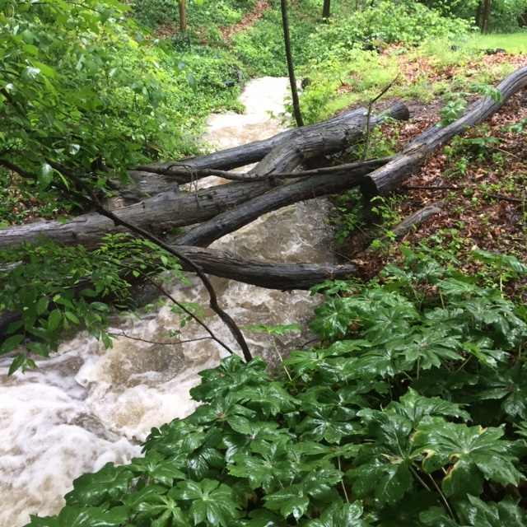
This is the picture before any water starts coming down the gully.
It starts at the top of Silver Valley Blvd and extends through Lake Terrace Drive.
Before it rains
While its raining same view

Slide 5
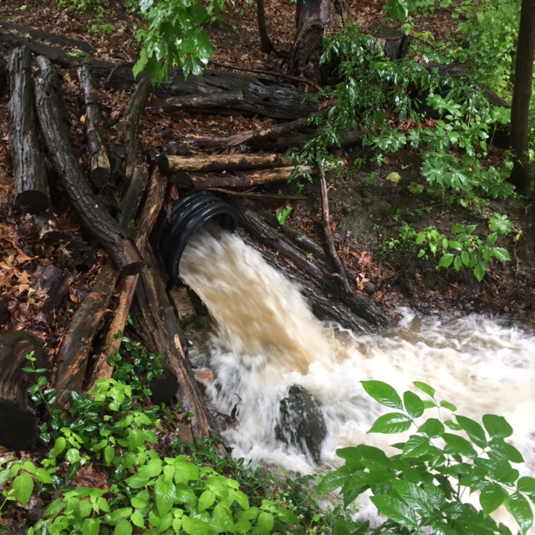
This is where the carnage starts,
At the top of Silver Valley Blvd. this is the easement located between 133 SVB and 155 SVB. It is a 24” pipe that I believe is fed by the apartments on RT91. It flows down the easement to an area that is approximately 20’ in area and then proceeds to flow down hill to slide #1, once it reaches there you cant stop it. The next slides are a result of the forces this causes. Please don’t think that this only happens every 100 years, that’s BS.
It happens every time it rains.

Slide 6
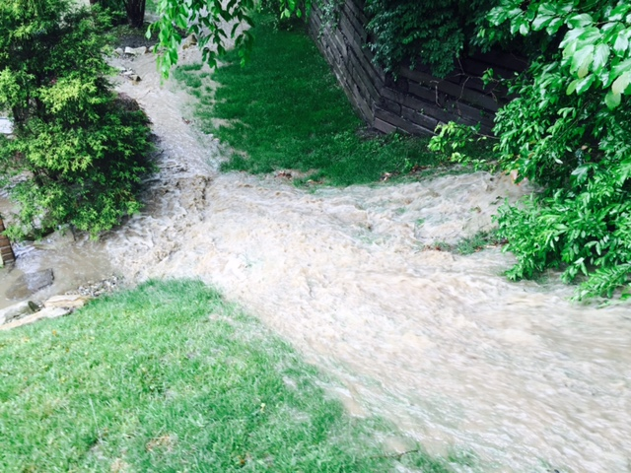
This is a result of the flow of water coming from SVB easement as shown in previous slides. As you can clearly see nothing is stopping this water. These are actual photo’s of the water running over the last spillway right outside 188 LTD. In the next few photos you will see the flow of water behind these 6 units.
Besides a serious flooding issue, this is a huge safety problem for our residents. We have electrical and other utilities that are vital to the well being of our residents.

Slide 7
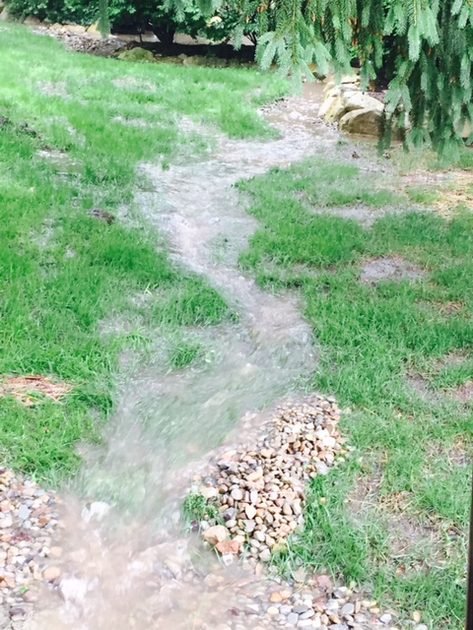
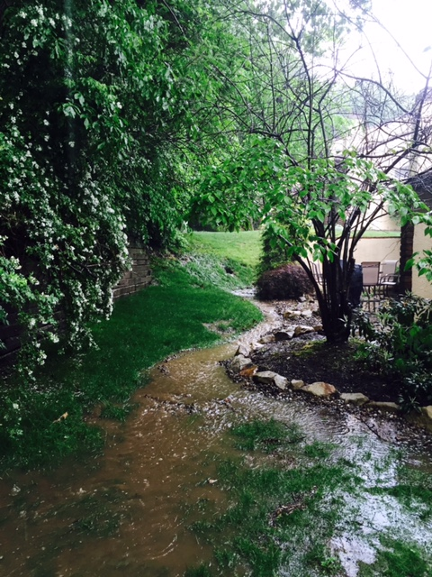
This is the same flow of water but from the other end of the units. So this 6 condo’s to the west of the waterfall in the previous slide.

Slide 8
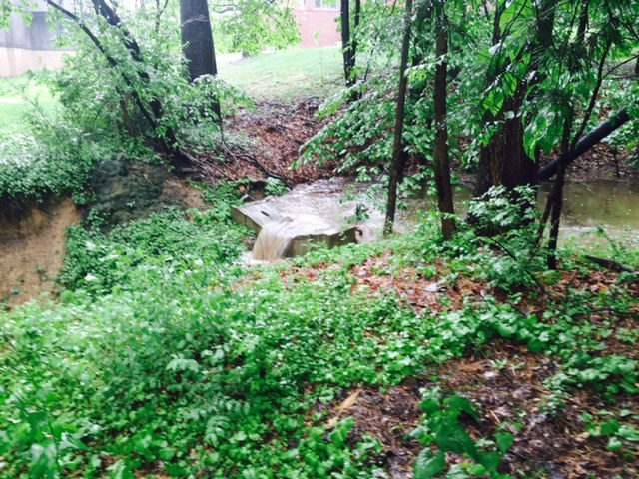
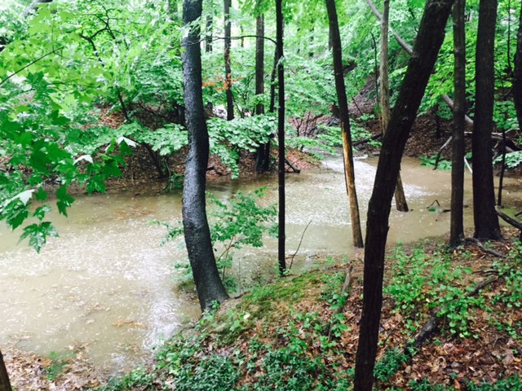
This is the recent spillway that was installed in the easement area to stop the flow of water before it gets to Lake Terrace, as you can see it DOESN’T stop anything. The photo below shows the water gathering before it gets to the first spillway. This water right now is over 6’ deep and is ready to breech the land to right of the water line. When it does that it floods the next set of condo’s to the east.

